Slide 1
ANALYZING AMAZON SALE DATA INTERNSHIP PROJECT REPORT
ANSHIKA BHATNAGAR

Slide 2
TABLE OF CONTENTS
1- PROJECT OVERVIEW
2- INTRODUCTION
3- PROJECT OVERVIEW
4-DETAIL ABOUT PROJECT
5- TOOL USE
6-DATASET OF PROJECT
7-MY DESIGN

Slide 3
Project overview
I have done this project as part of the Unified mentor Internship. If you are looking for some remote internship opportunity you can check out Unified mentor Internship, where you can find internship for different technologies in different domains.

Slide 4
INTRODUCTION
Sales analysis is reviewing your sales data to identify trends and patterns. Sales data can help you make better decisions about your product, pricing, promotions, inventory, customer needs other aspects of your business. Sales analysis can be as simple as reviewing your sales figures regularly.

Slide 5
Detail about project
Sales management has gained importance to meet increasing competition and the need for improved methods of distribution to reduce cost and to increase profits. Sales management today is the most important function in a commercial and business enterprise. The objective of the project is to Analyze Amazon Sales data to get a substantial data which will help in bringing changes in a business in the future. It will help to reveals flaws in the business model or in the way that one is going about conducting business. Sellers will be able to clearly see where they’re losing money, what the problem is, and reduce their losses accordingly. It facilitates coming up with strategic solutions to problems. This project aims to provide visual understanding of the data using Microsoft Power Bi.

Slide 6
Tool used
Microsoft Excel Microsoft Power Bi.

Slide 7
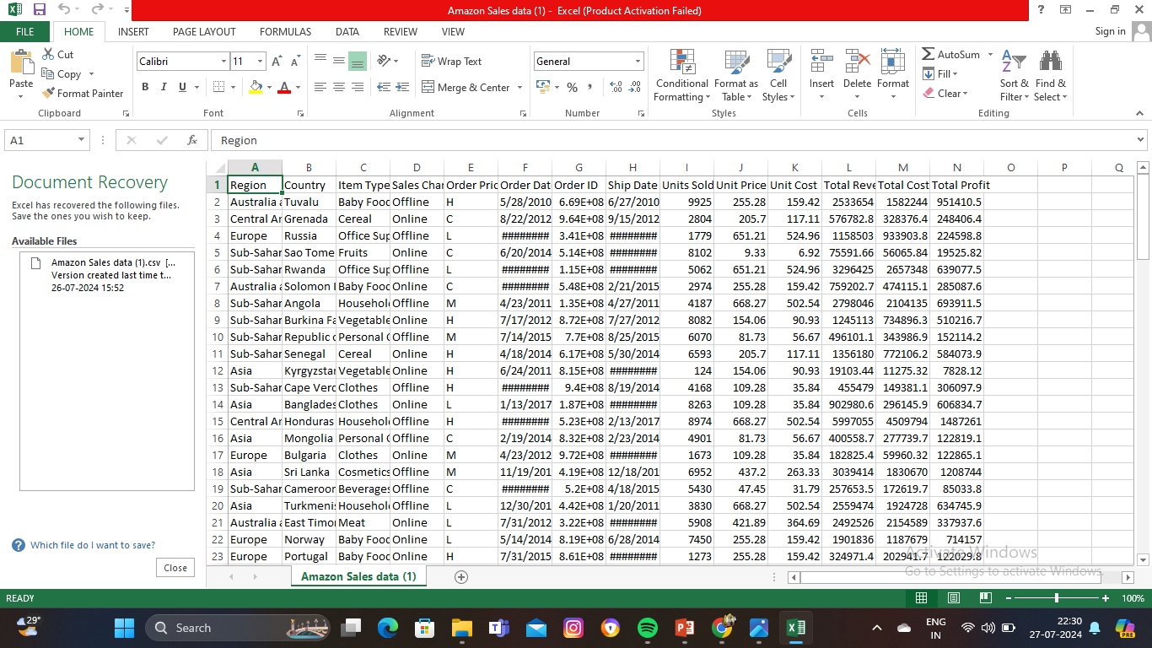
DATASET OF PROJECT

Slide 8
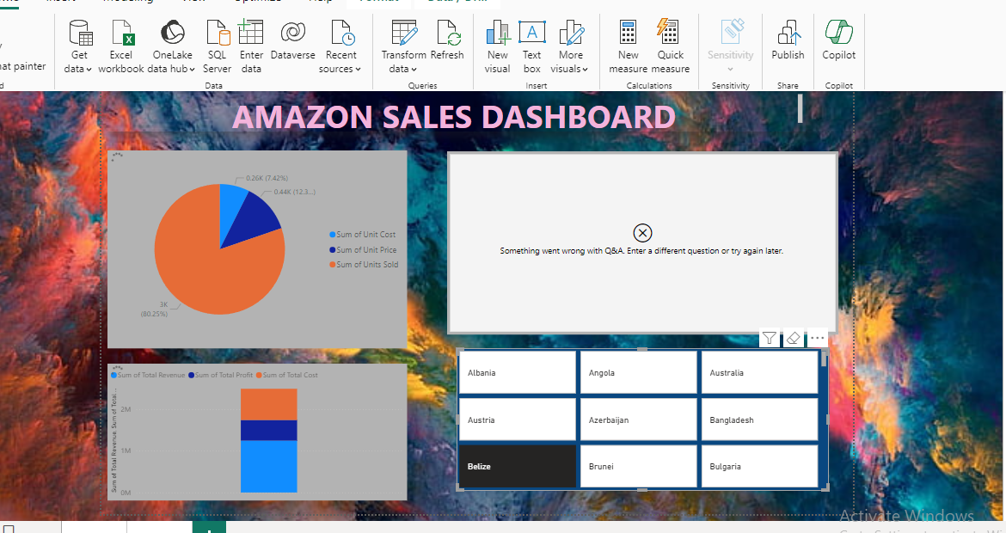
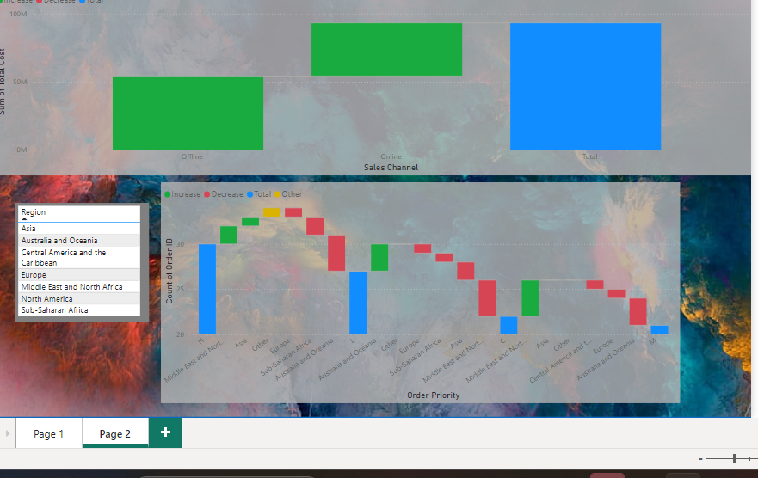
My dashboard designs

Slide 9
THANKYOU

